Slide 1
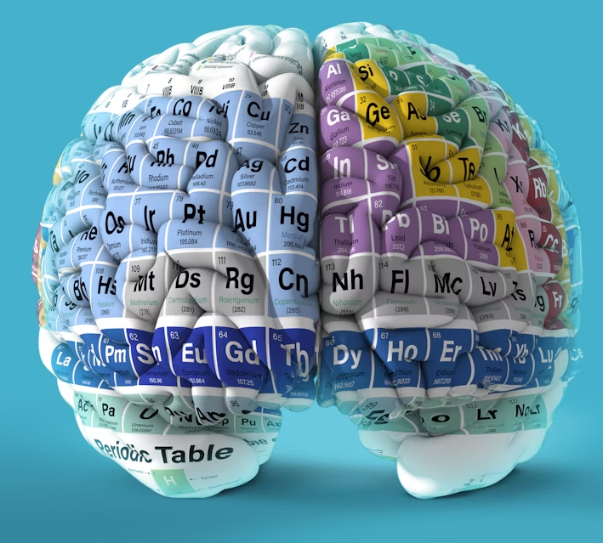
Groups 7 elements
Lesson objectives
To identify the halogens on the Periodic table.
To describe how the properties of the halogens change as you move down the group.
To predict the properties of a halogen based on its position in the Periodic table.
Brain teaser
Keywords: Periodic Table, group 7, halogens

Slide 2
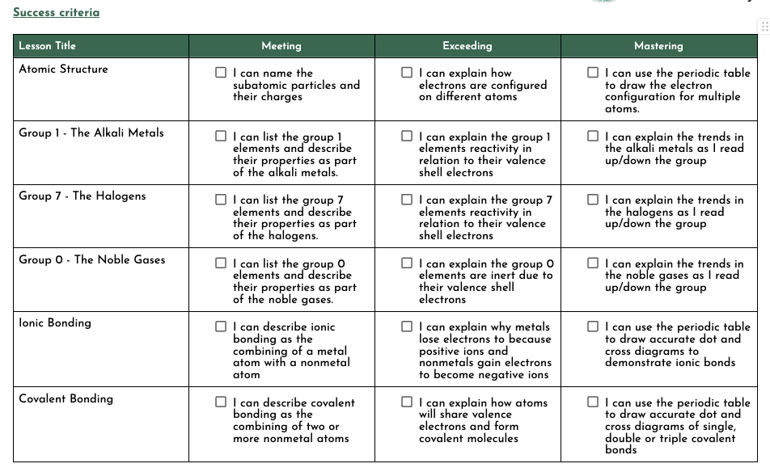

Slide 3

Displacement
Replacing a less reactive element with a
more reactive one in a compound.
(you can think of displacement as replacement)

Slide 4
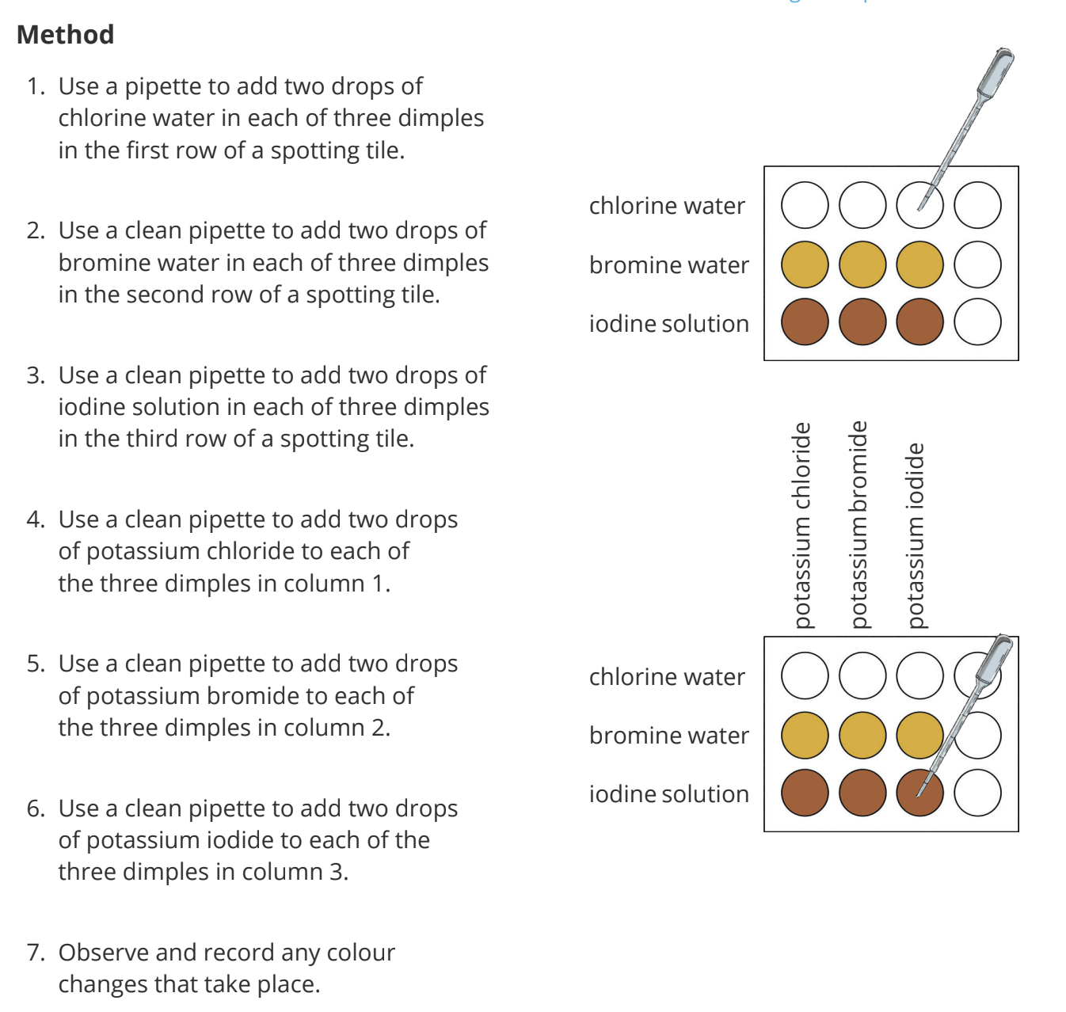




Slide 5
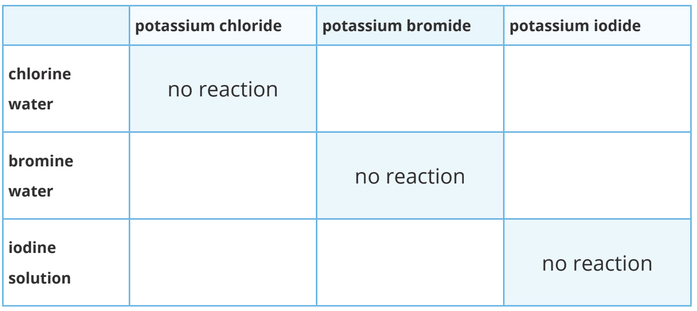
Results

Slide 6
Results
A colour change will only occur if the halogen present in the halogen solution is more reactive than the halogen present in the potassium salt.
The combinations of solutions highlighted in the table below will not react.
Since each of the solutions contain the same halogen, displacement will not occur. You can use these reactions as colour controls:
After mixing, if the colour of the solutions remains the same as the highlighted mixture in that row, then no reaction has occurred. Write no reaction in the box.
After mixing, if the colour of the solutions changes from the highlighted mixture in that row, then describe the colour change in the box.

Slide 7
Results
Which is the most reactive of the three halogens? Explain how you know.
Which is the least reactive of the three halogens? Explain how you know.

Slide 8
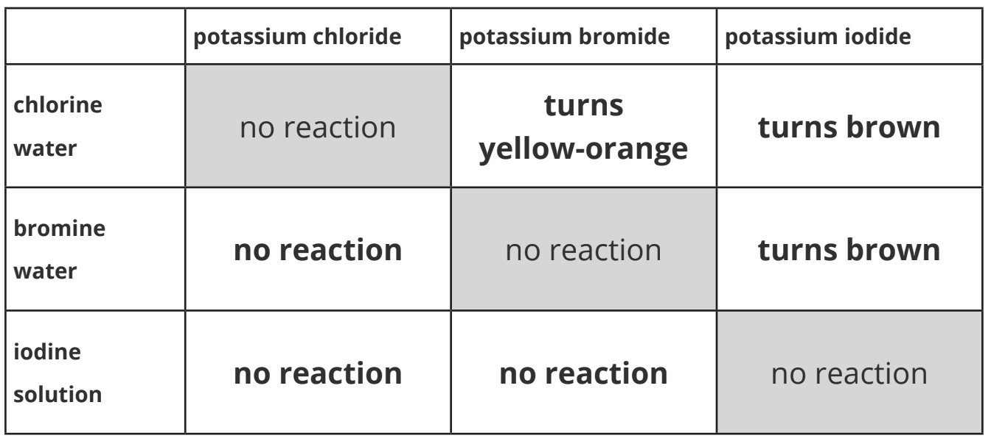
Answers
Chlorine is the most reactive as it was able to displace both bromine and iodine from their potassium salts. Chlorine could not be displaced from its salt by either bromine or iodine.
Iodine is the least reactive as it was displaced from its salt by both chlorine and bromine. It was not able to displace either chlorine or bromine from their salts.

